Slide 1
Bioinformatics
Faster, better, stronger

Slide 2
De stof komt uit de college presentaties en Jonathan Pevsner "Bioinformatics and Functional Genomics"
(Wiley Blackwell; 3e editie) en een aantal extra papers
(deze worden niet expliciet in de betrokken colleges genoemd, en zijn te vinden onder "achtergrond").
Lecture | Topic | Chapter | Pages | Comments
1 | Bioinformatics | 1 | Helemaal
2 | Access to seq data | 2 | Helemaal | Niet "Command line access"
3 | Sequence Alignment | 3 | 70-103 | Niet box 3.5, box 3.7, box 3.8
4 | BLAST | 4 | 121-134, 138-143, 145-159 | Niet fig.4.14, box 4.1, p.143 E- en p-values
5 | Database searching | 5 | 171-177 | Niet box 5.1
6 | Next Generation Sequencing | 9 | 377-384

Slide 3
Presentation content
Chapter 1

Slide 4
Chapter 1:
Introduction to Bioinformatics
and Functional Genomics
Jonathan Pevsner, Ph.D.
http://bioinfbook.org
pevsner@kennedykrieger.org
Bioinformatics and Functional Genomics
(3rd edition, ©2015 John Wiley & Sons, Ltd.)
You may use this PowerPoint for teaching purposes

Slide 5
Definitions of bioinformatics and genomics
Bioinformatics is the use of computer databases and computer algorithms to analyze proteins, genes, and the complete collection of deoxyribonucleic acid (DNA) that comprises an organism (the genome).
According to a National Institutes of Health (NIH) definition, bioinformatics is “research, development, or application of computational tools and approaches for expand- ing the use of biological, medical, behavioral, or health data, including those to acquire, store, organize, analyze, or visualize such data.”
B&FG 3e
Page 3

Slide 6
Bioinformatics – cell

Slide 7
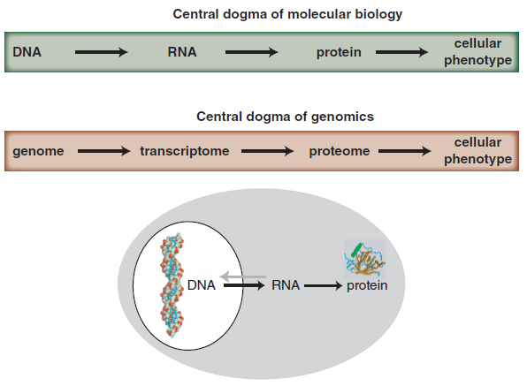
Central dogma of molecular biology & genomics
B&FG 3e
Fig. 1-1
Page 4

Slide 8
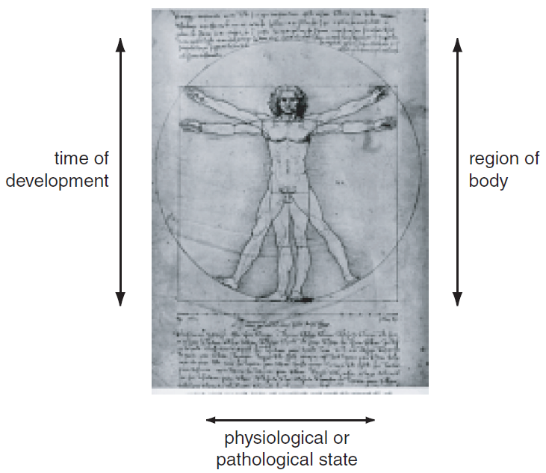
Growth of DNA sequence in repositories
B&FG 3e
Fig. 1-2
Page 6

Slide 9
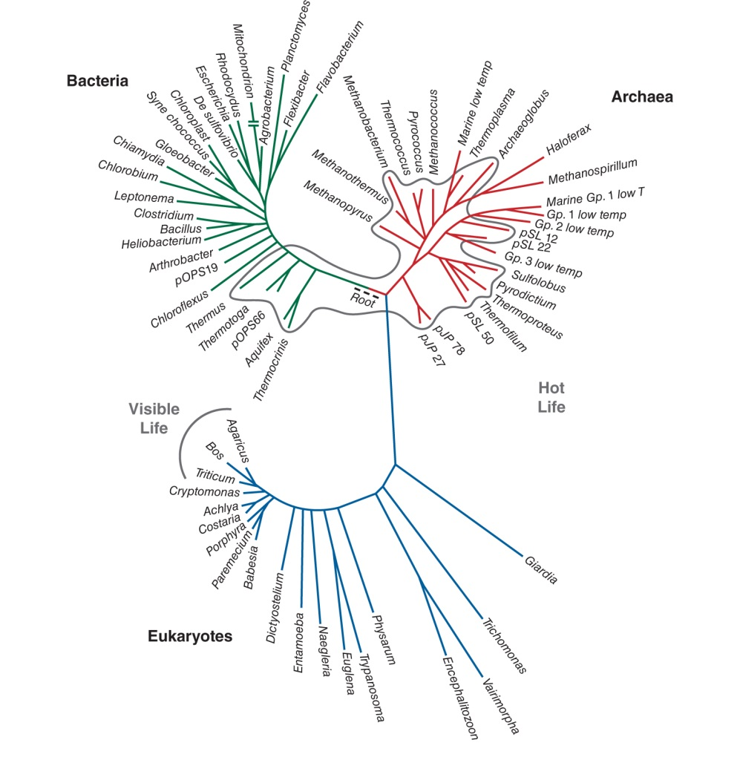
Three domains of life: bacteria, archaea, eukaryotes
B&FG 3e
Fig. 1-3
Page 7

Slide 10
Bioinformatics and genomics: two cultures
Many bioinformatics tools and resources are available on the internet, such as major genome browsers and major portals (NCBI, Ensembl, UCSC).
These are:
accessible (requiring no programming expertise)
easy to browse to explore their depth and breadth
very popular
familiar (available on any web browser on any platform)
B&FG 3e
Fig. 2-3
Page 22

Slide 11
Figure 1.5
Bioinformatics and Functional Genomics (3rd ed., 2015)

Slide 12
Bioinformatics and genomics: two cultures
Many bioinformatics tools and resources are available on the command-line interface (sometimes abbreviated CLI).
These are often on the Linux platform (or other Unix-like platforms such as the Mac command line). They are essential for many bioinformatics and genomics applications.
Most bioinformatics software is written for the Linux platform.
Many bioinformatics datasets are so large (e.g. high throughput technologies generate millions to billions or even trillions of data points) requiring command-line tools to manipulate the data.
B&FG 3e
Page 22

Slide 13
Should you learn to use the Linux operating system? Yes, if you want to use mainstream bioinformatics tools.
Should you learn Python or Perl or R or another programming language? It’s a good idea if you want to go deeper into bioinformatics, but also, it depends what your goals are. Many software tools can be run in Linux on the command-line without needing to program.
Think of this figure like a map. Where are you now? Where do you want to go?

Slide 14
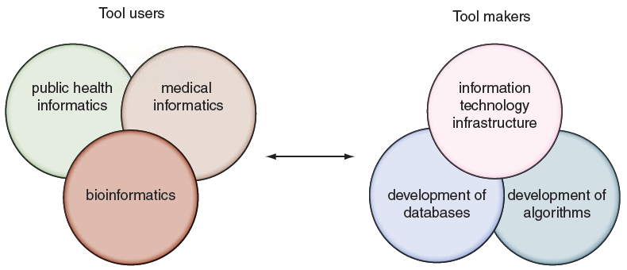
Tool makers and tool users across informatics disciplines
B&FG 3e
Fig. 1.6
Page 15

Slide 15
Tool makers and tool users across informatics disciplines
Many informatics disciplines have emerged in recent years. Bioinformatics is distinguished by its particular focus on DNA and proteins (impacting its databases, its tools, and its entire culture).
B&FG 3e
Fig. 1.6
Page 15

